Slide 1





DEVANSH VERMA
2023 Batch CS

Slide 2

From Our Campus to McKinsey - Your Inspiring Journey Begins
Hey there, fellow Bhartians students! It's an incredible feeling to stand before you today as a familiar face.
Just like many of you, I walked these same halls not too long ago, full of aspirations and dreams.
I'm here to share a bit of my journey, to inspire you, and to show you that the path from student to success isn't as distant as it may seem.
I'm proud to represent McKinsey & Company as an Associate, working on impactful projects and collaborating with some of the sharpest minds in the industry.

Slide 3


About McKinsey & Company
Our Story
Our Reputation
Founded in 1926, McKinsey & Company is a leading global management consulting firm.
The firm quickly expanded globally, becoming a leading management consulting firm with offices in over 120 cities and a diverse team of professionals.
Our reputation for professional excellence attracts the best talent, the most challenging projects, and the most exciting opportunities from around the world
Its consulting services cover various industries, making it a preferred choice for a wide range of clients..
Our Culture
We believe that sharing diverse ideas and perspectives leads to better outcomes for our clients.
McKinsey is known for fostering a culture of collaboration and teamwork, where consultants from diverse backgrounds work together to tackle complex issues.

Slide 4


Client Focus
Results-Oriented
Intellectual Excellence
Inclusivity and Diversity
Stewardship
Personal Growth
Core Values

Slide 5












Consulting Services We Offer
Strategy Consulting
Social Sector Consulting
Marketing and Sales
Operations Consulting
Organizational
Transformation
Sustainability and ESG
Digital Transformation
Mergers and Acquisitions
(M&A)
Life Risk Management
and Compliance
These are just some of the consulting services McKinsey offers. Junior consultants at McKinsey often have the opportunity to work on a diverse range of projects across different industries and functions, gaining valuable experience and exposure to various aspects of business and management consulting.

Slide 6


Benefits of a Career in Consulting with McKinsey
Learning and Development | Exposure to Diverse Industries | Problem-Solving Mastery
Global Network | Client Interaction | Leadership Development
Merit-Based Advancement | Compensation and Benefits | Alumni Network
Work-Life Balance Initiatives | Entrepreneurial Opportunities | Career Flexibility

Slide 7
Unparalleled Culture: Why McKinsey Excels
INCLUSIVE EXCELLENCE |  | MENTORSHIP MASTERY |  | EXCEPTIONAL SUPPORT
Our culture weaves a tapestry of diverse perspectives, and our commitment to inclusivity is the driving force behind extraordinary results at McKinsey. |  | Our mentorship programs are career accelerators, where dedicated mentors champion your growth at McKinsey. |  | At McKinsey, we're not just colleagues; we're a nurturing family that values your holistic development through well-being programs.
Leading in the competitive corporate world with inclusivity, mentorship, unparalleled support, and attractive salary advantages. Join us for unmatched commitment to your success.

Slide 8

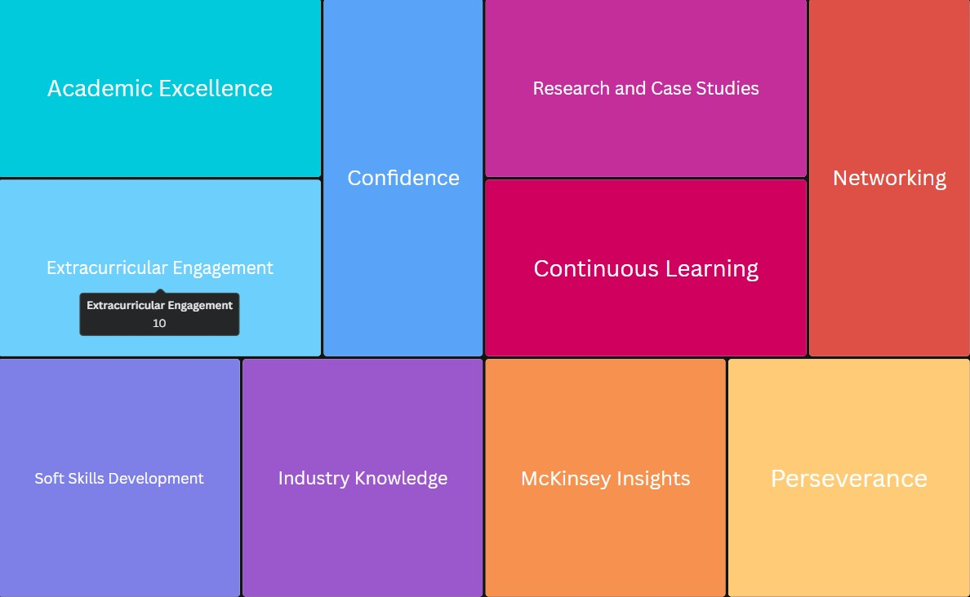
Building Your Path to McKinsey Excellence
Remember, the path to McKinsey is demanding but rewarding. Start building these skills and experiences now to set yourself on the right track for a successful future with us.

Slide 9

Q&A Session
Engage, Ask, Learn
Your questions are not just welcome; they are essential for our journey together.

Slide 10

Company website
https://www.mckinsey.com/in/overview
Explore Career
https://www.mckinsey.com/careers/students
Contact us
https://www.mckinsey.com/contact-us
My Mail ID
devanshverma711@gmail.com
Additional Resources

Slide 11

Thank You
Your attention and curiosity are deeply appreciated.
I hope you found our exploration insightful and inspiring.
Should you choose to pursue a career with McKinsey, I look forward to the possibility of welcoming you as an Associate Consultant.
Together, we can unlock a world of possibilities and impact.
Thank you, and I hope you're as excited as I am about the prospect of joining McKinsey as an Associate Consultant.

